Slide 1

Chapter 1:
Introduction to R Programming for Data Science

Slide 2
Introduction to R Language 1

Slide 3
Objectives
Explain what R language is and the purpose of R
Download and Install R
Learn general Issues in R
Introduce R-Packages

Slide 4


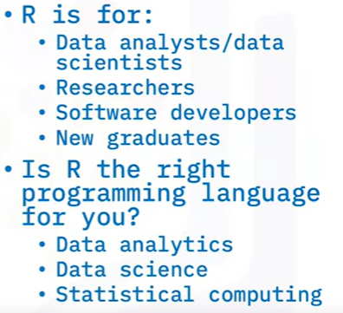
Introduction to
R Programming for Data Science

Slide 5

Introduction to
R Programming for Data Science
2
3
1
4
Notes:
So, what makes R so good?
First, R is an open-source language, which means you can review the source code for free
and even modify it.
Being open-source, you can leverage and integrate cutting-edge research into your analytics,
such as the latest AI algorithms.
Second, R has rich data science libraries that include everything you need to do data
processing, data visualization, and modelling to facilitate your own research and development.
Third, R is simple and easy to understand.
Its simple syntax allows you to learn it very quickly.
Finally, R has an extensive and rich community of support, so you can very easily find answers
to your questions online.

Slide 6
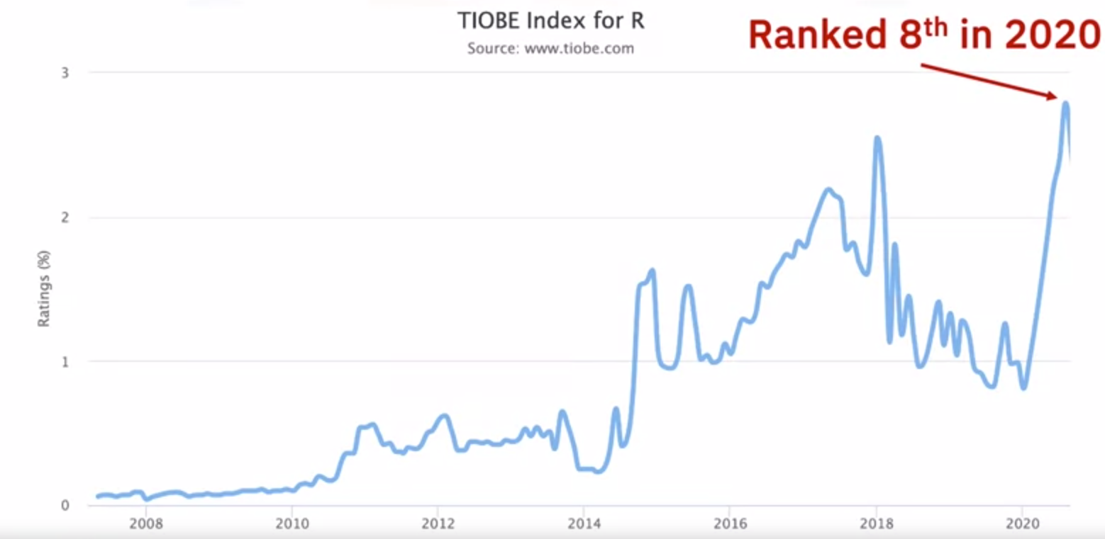
Introduction to
R Programming for Data Science

Slide 7
What is R?
Software for Statistical Data Analysis
Based on S
Programming Environment
Interpreted Language
Data Storage, Analysis, Graphing
Free and Open Source Software

Slide 8
Obtaining R
Current Version: R-4.2.2
Comprehensive R Archive Network:
http://cran.r-project.org
Binary source codes
Windows executables
Compiled RPMs for Linux

Slide 9
Installing R
Binary (Windows/Linux): One step process
Starting R

Slide 10
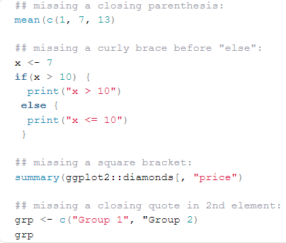
General Issues in R
1. Unmatched parentheses, curly braces, square brackets or quotes
Solution
Using RStudio a closing parenthesis, curly brace, square bracket or quotation mark will automatically be written when opening one
Match all opening parentheses, curly braces, square brackets and quotation marks with their closing counterparts

Slide 11
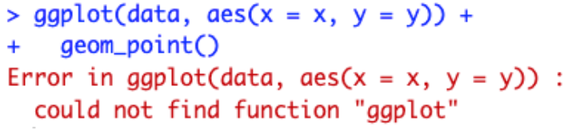
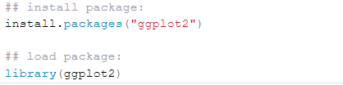
General Issues in R
2. Using a function that is not installed or loaded
Solution
Install the package (if it is not installed yet) and load it with the install.packages() and library() functions, respectively:

Slide 12
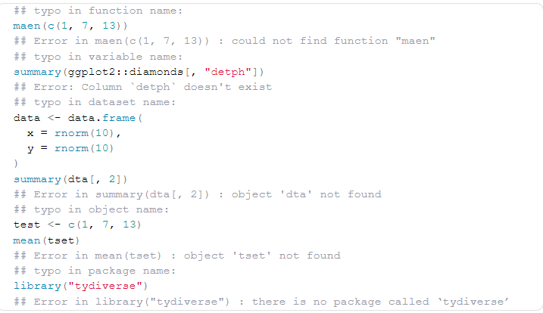
General Issues in R
3. Typos in function, variable, dataset, object or package names
Solution
Make sure that you correctly spell all your functions, variables, datasets, objects and packages

Slide 13
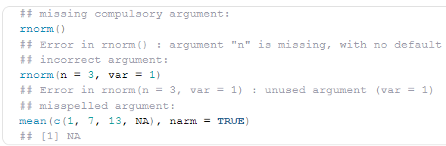
General Issues in R
4. Missing, incorrect or misspelled arguments in functions
Most R functions require arguments
Solution
Make sure to specify at least all compulsory arguments of the function, and the correct ones
If we do not know the arguments of a function, we can always check the documentation with ?function_name or help(function_name)

Slide 14
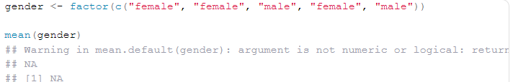
General Issues in R
5. Wrong, inappropriate or inconsistent data types
Solution
Make sure to use the appropriate operation and type of analysis depending on the variable(s) of interest. For example:
for factor variables => compute frequencies and/or relative frequencies, and draw barplots
for quantitative continuous variables => compute the mean, median, etc. and draw histograms, boxplots, etc.
for logical variables, the mean, a frequency table and a barplot are appropriate

Slide 15
General Issues in R
6. Misunderstanding between = and ==
Assignment in R can be done in three ways, from the most to the least common:
  <-, =, assign()
The second method, that is =, should not be confused with ==

Slide 16

General Issues in R
7 . Undefined columns selected
R does not understand the column you want to use while subsetting the dataset.
Solution
Dataframes in R have two dimensions: rows and columns and in that particular order so row first, then column. R expects two dimensions when you call dat[]
It expects the first and then the second dimension, separated by a comma:

Slide 17
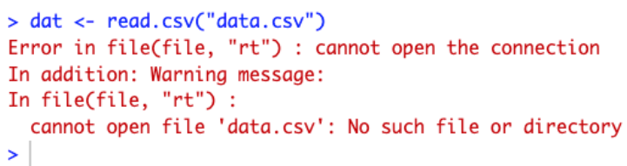
General Issues in R
8. Problem when importing or using the wrong data file
Solution
Specify the path to the folder where your dataset is located

Slide 18
R-Packages
R packages are a collection of R functions, complied code and sample data. They are stored under a directory called "library" in the R environment
There are two types of packages:
  Packages included with the base installation: a set of packages are installed by R during installation
  Packages not included with the base Installation: packages that you must manually download and install.
Chapter1- Importing Datasets

Slide 19

R-Packages
When starting the R console, only the default packages are available by default.
Check Available R Packages
  Get library locations containing R packages
Chapter1- Importing Datasets

Slide 20
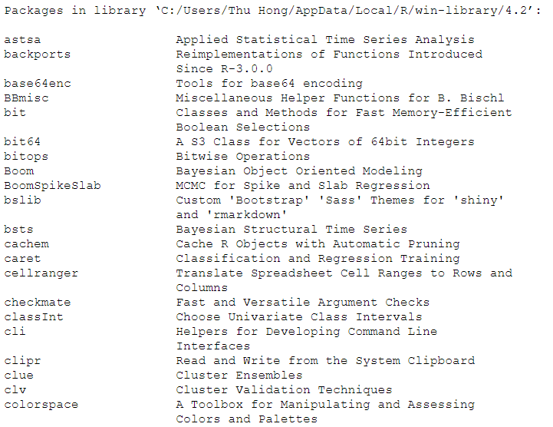
R-Packages
Check Available R Packages
  Get the list of all the packages installed

Slide 21
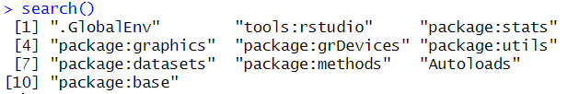
R-Packages
Check Available R Packages
  Get all packages currently loaded in the R environment

Slide 22
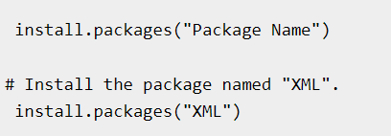
R-Packages
Install a New Package
  Packages are added when they are needed for some specific purpose
  There are two ways to add new R packages:
    Installing directly from the CRAN directory
    Downloading the package to the local system and installing it manually.
Install directly from CRAN

Slide 23
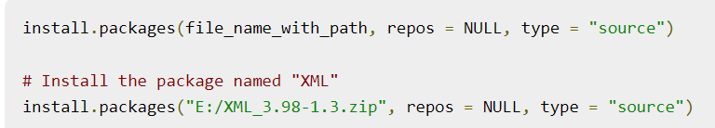
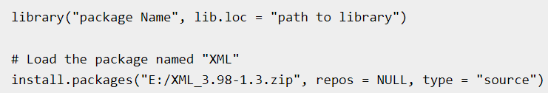
R-Packages
Install package manually
Go to the link R Packages to download the package needed. Save the package as a .zip file in a suitable location in the local system.
  Load Package to Library
  Before a package can be used in the code, it must be loaded to the current R environment

Slide 24
Summary
Explain what R language is and the purpose of R
Download and Install R
Introduce R-Packages
General Issues in R

Slide 25
Q & A

